Slide 1


Sagar Varandekar
18-04-2022

Slide 2

Outline
Executive Summary
Introduction
Methodology
Results
Conclusion
Appendix

Slide 3
Executive Summary
Summary of methodologies
Data collection
Data wrangling
EDA with data visualization
EDA with SQL
Building an interactive map with Folium
Building a Dashboard with Plotly Dash
Predictive analysis (Classification)
Summary of all results
Exploratory data analysis results
Interactive analytics demo in screenshots
Predictive analysis results

Slide 4
Introduction
Project background and context
We predicted if the Falcon 9 first stage will land successfully. SpaceX advertises Falcon 9 rocket launches on its website, with a cost of 62 million dollars; other providers cost upward of 165 million dollars each, much of the savings is because SpaceX can reuse the first stage. Therefore, if we can determine if the first stage will land, we can determine the cost of a launch. This information can be used if an alternate company wants to bid against SpaceX for a rocket launch.
Common problems that needed solving
How different conditions and locations influence landing success.
The influence of different rocket variables on the success rate of a rocket landing.
What conditions does SpaceX have to achieve to get the best results and ensure the best rocket success landing rate.

Slide 5

Section 1

Slide 6
Methodology
Executive Summary
Data collection methodology:
Required data was retrieved from SpaceX API and web scraped to collect Falcon 9 historical launch records from a Wikipedia page.
Performed data wrangling
Imputed missing values with mean and other appropriate methods. One Hot Encoding data fields for Machine Learning and dropping irrelevant columns
Performed exploratory data analysis (EDA) using visualization and SQL
Performed interactive visual analytics using Folium and Plotly Dash
Performed predictive analysis using classification models
Different models were trained and various hyper-parameter values tuned. Model with highest accuracy amongst these models with tuned hyper-parameters was selected.

Slide 7
Data Collection
Required data was retrieved from SpaceX API by making a get request to the SpaceX API.
Data was also web scraped to collect Falcon 9 historical launch records from a Wikipedia page titled ‘list of Falcon 9 and Falcon heavy launches’ using python BeautifulSoup library.
Our goal is to use this data to predict whether SpaceX will attempt to land rocket first stage or not.

Slide 8
Data Collection – SpaceX API
Getting response from API
Converting Response JSON file to a DataFrame
Apply custom functions to clean data
Get lists from these custom functions
GitHubURL
Assign lists to Dictionary then Dataframe
Filter DataFrame and convert to flat file format (.csv)

Slide 9
Data Collection - Scraping
Getting response from HTML
Creating BeautifulSoup Object
Finding Tables
Getting column names
Creation of Dictionary
Appending data to keys
GitHubURL
Converting dictionary to dataframe
Converting Dataframe to .csv file

Slide 10
Data Wrangling
Retrieved data was cleaned and transformed so that it can be used for modeling.
Landing outcome column was modified to have only two values 1 for all kinds of success and 0 for all kinds of failure.
Landing outcome set as the Target feature.
Missing values in Payload column were replaced with the mean value.
Irrelevant columns were dropped.
Columns having categorical values were one hot encoded and column was created for each categorical value dropping the original column.
Determining Target variable
Separating and modifying Target column
Checking Null values
Imputing missing values with appropriate values
Dropping Irrelevant columns.
GitHubURL

Slide 11
EDA with Data Visualization
Scatter Graphs being drawn:
Flight Number VS. Payload Mass
Flight Number VS. Launch Site
Payload VS. Launch Site
Orbit VS. Flight Number
Payload VS. Orbit Type
Orbit VS. Payload Mass
Bar Graph being drawn:
Mean VS. Orbit
The Bar graph shows the success rate for different orbits.
Line Graph being drawn:
Success Rate VS. Year
The scatter graphs shows how successful and failed landing outcomes were distributed against different parameters.
The line graph shows the trend of success rate with each passing year.
GitHubURL

Slide 12
EDA with SQL
Displayed the names of the unique launch sites in the space mission using DISTINCT command.
Display 5 records where launch sites begin with the string 'CCA‘ using WHERE and LIKE command.
Display the total payload mass carried by boosters launched by NASA (CRS) using SUM and WHERE command.
Display average payload mass carried by booster version F9 v1.1 using AVG command.
Listed the date when first successful landing outcome in ground pad was achieved using MIN command.
Listed the names of the boosters which have success in drone ship and have payload mass greater than 4000 but less than 6000 using WHERE and BETWEEN command.
Listed the total number of successful and failure mission outcomes using COUNT command.
Listed the names of the booster_versions which have carried the maximum payload mass using MAX command in a subquery.
List the failed landing_outcomes in drone ship, their booster versions, and launch site names for in year 2015 using WHERE and AND command.
Ranked the count of landing outcomes between the date 2010-06-04 and 2017-03-20, in descending order using GROUPBY and ORDERBY command.
GitHubURL

Slide 13
Build an Interactive Map with Folium
To visualize the Launch Data into an interactive map. We took the Latitude and Longitude Coordinates at each launch site and added a Circle Marker around each launch site with a label of the name of the launch site.
We assigned the dataframe launch_outcomes(failures, successes) to classes 0 and 1 with Green and Red markers on the map in a MarkerCluster() to show successful/failure launches for each launch site.
Using Haversine’s formula we calculated the distance from the Launch Site to various landmarks to find various trends about what is around the Launch Site to measure patterns. Lines are drawn on the map to measure distance to landmarks.
GitHubURL

Slide 14
Build a Dashboard with Plotly Dash
Pie chart of Launch Success counts for all sites and success rate of launches for each site was created in the dashboard.
Dropdown was added to the dashboard to select launch site.
Scatter Plot of Payload Mass vs Landing outcome was plotted with a slider for payload given to select payload range. Colors to data points with different booster versions.
Pie Chart for all sites showed launch site with highest count of launch success.
Pie chart for each launch site showed respective success rate with highest success rate of site KSC LC-39A.
GitHubURL

Slide 15
Predictive Analysis (Classification)
BUILDING MODEL
Load our dataset into NumPy and Pandas
Transform Data
Split our data into training and test data sets
Decide which type of machine learning algorithms we want to use
Set our parameters and algorithms to GridSearchCV
Fit our datasets into the GridSearchCV objects and train our dataset.
EVALUATING MODEL
Check accuracy for each model
Get tuned hyperparameters for each type of algorithms
Plot Confusion Matrix
IMPROVING MODEL
Feature Engineering
Algorithm Tuning
FINDING THE BEST PERFORMING CLASSIFICATION MODEL
The best model is the model with the best accuracy score on the test data.
Accuracy score of all models was same on test data hence model with highest accuracy score on training data was selected.
GitHubURL

Slide 16
Results
Exploratory data analysis results
Interactive analytics demo in screenshots
Predictive analysis results

Slide 17

Section 2

Slide 18
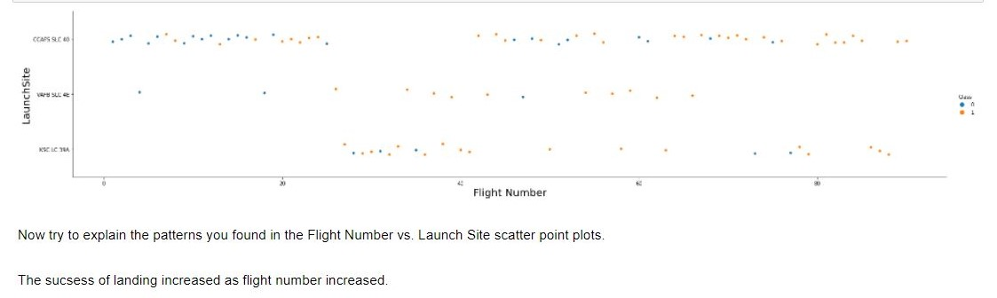
Flight Number vs. Launch Site

Slide 19
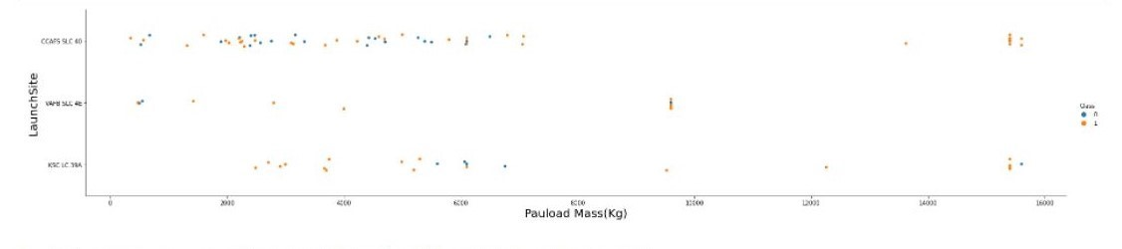
Payload vs. Launch Site
No inferences can be drawn from this scatter chart.

Slide 20
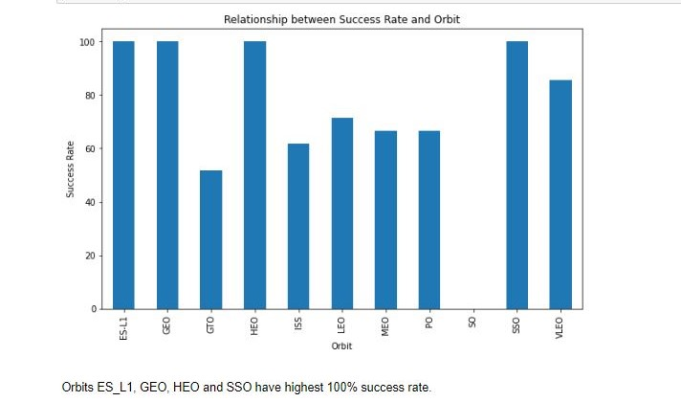
Success Rate vs. Orbit Type

Slide 21
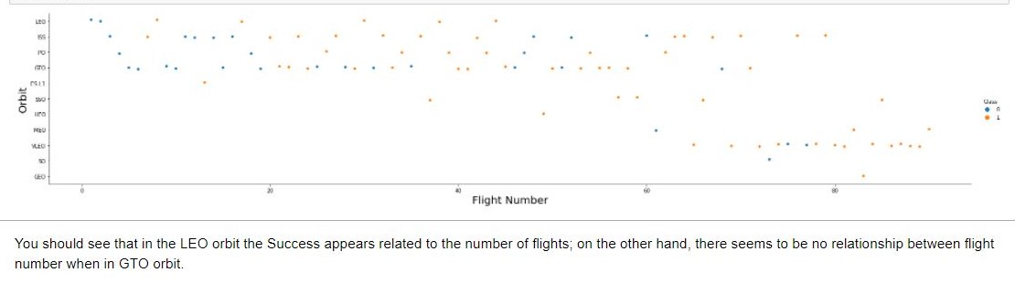
Flight Number vs. Orbit Type

Slide 22
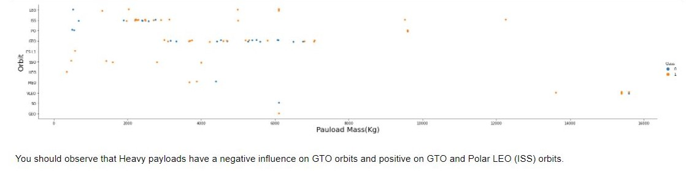
Payload vs. Orbit Type

Slide 23
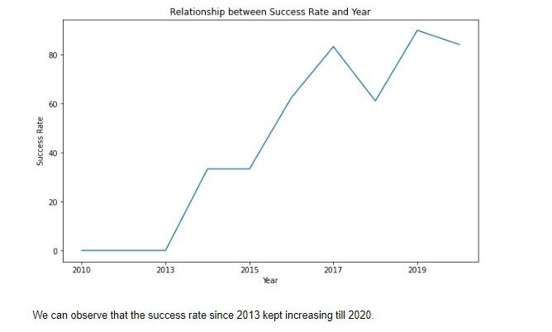
Launch Success Yearly Trend

Slide 24
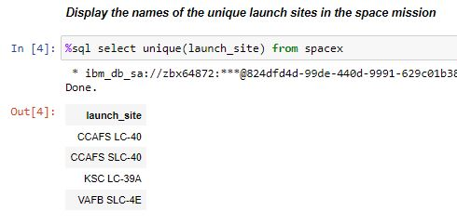
All Launch Site Names

Slide 25
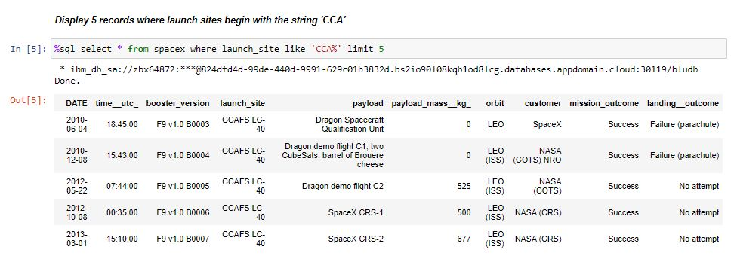
Launch Site Names Begin with 'CCA'

Slide 26
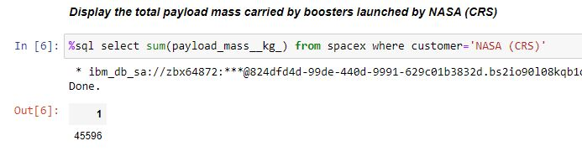
Total Payload Mass for NASA

Slide 27
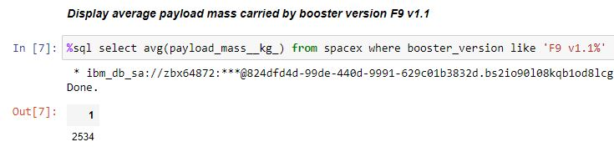
Average Payload Mass by Booster Version F9 v1.1

Slide 28
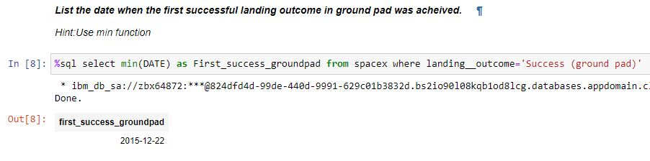
First Successful Ground Landing Date

Slide 29
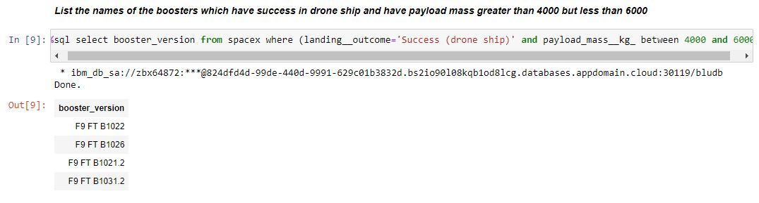
Successful Drone Ship Landing with Payload between 4000 and 6000

Slide 30
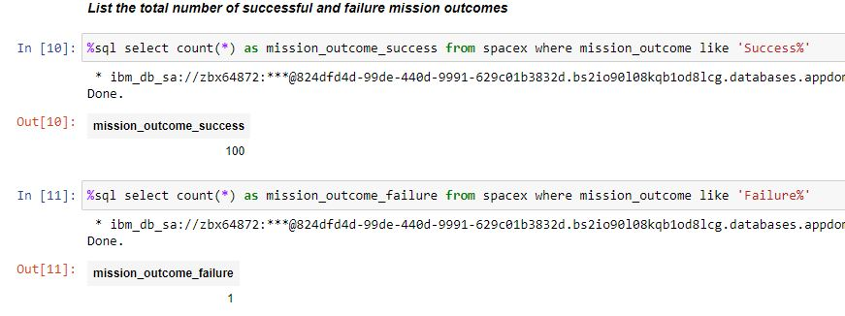
Total Number of Successful and Failure Mission Outcomes

Slide 31
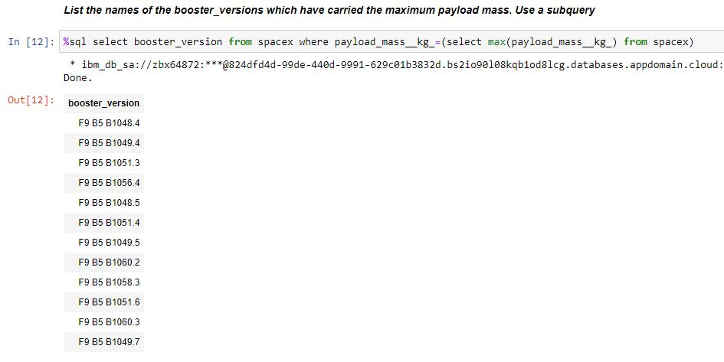
Boosters Carried Maximum Payload
Booster Version F9 B5 carried maximum payload.

Slide 32
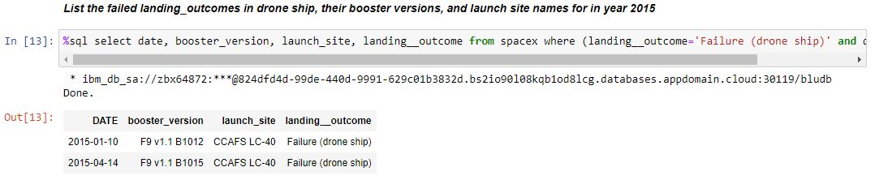
2015 Launch Records of Failed landing outcome-Drone Ship

Slide 33
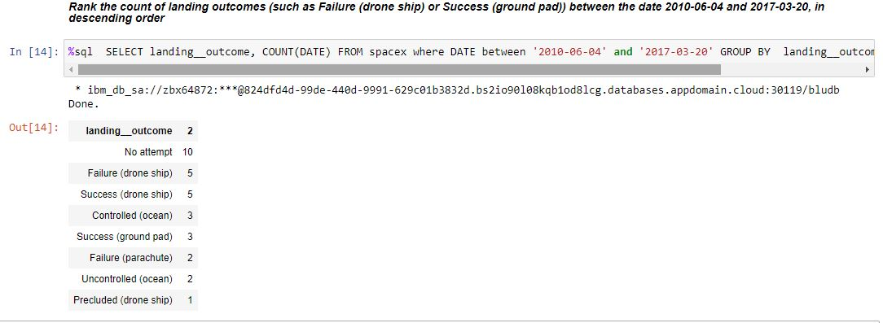
Rank Landing Outcomes Between 2010-06-04 and 2017-03-20

Slide 34

Section 3

Slide 35
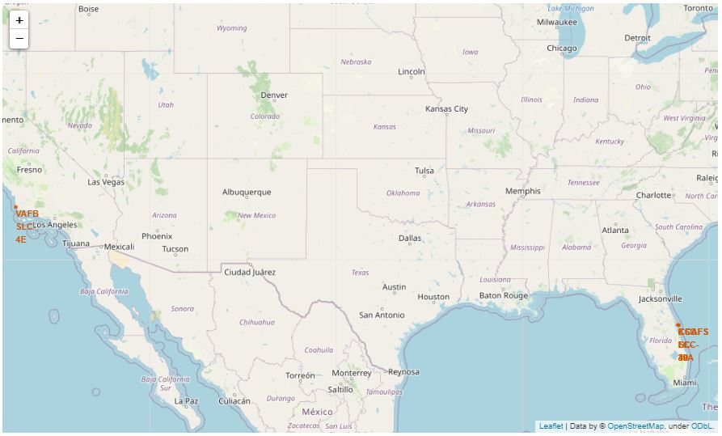
Launch Sites marked on Map
Three launch sites are close to each other in Orlando, Florida and only one launch site is in coastal area in California.

Slide 36
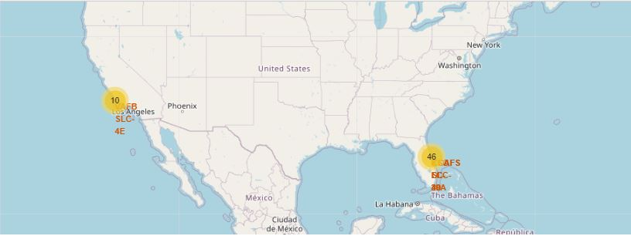
Success/failed launches clustered for each site marked on the map
MarkerCluster Object was used to mark success/failure of launch sites.

Slide 37
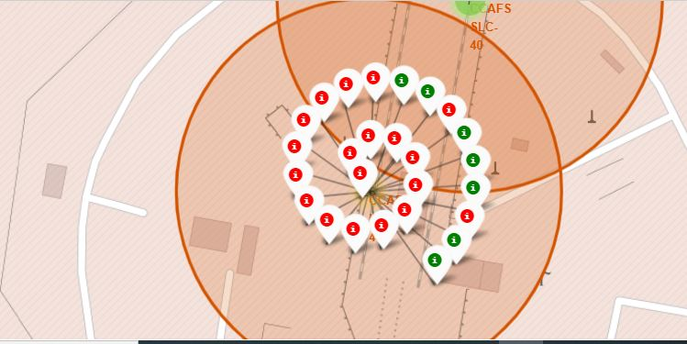
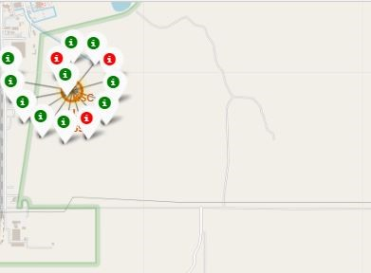
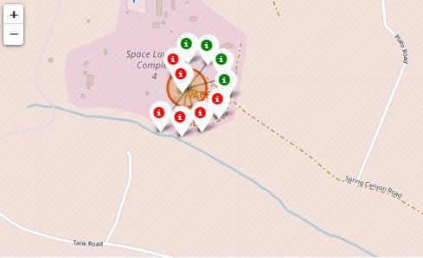
Success/failed launches for each site marked on the map
Launch Site KSC LC-39A has highest success ratio.

Slide 38
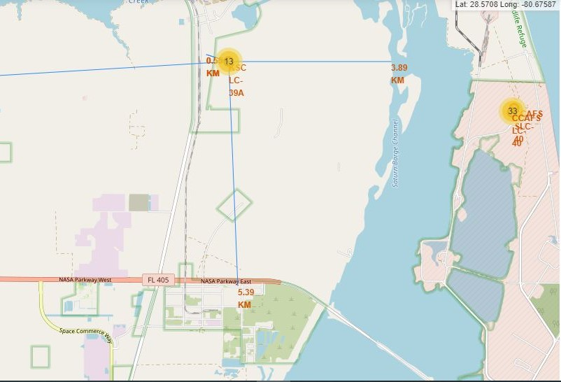
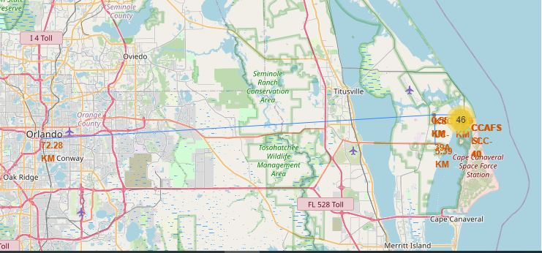
Distances between a launch site to its proximities
Launch Sites are not in proximity of railway, highway, city etc. Launch sites are near coastline.

Slide 39

Section 4

Slide 40
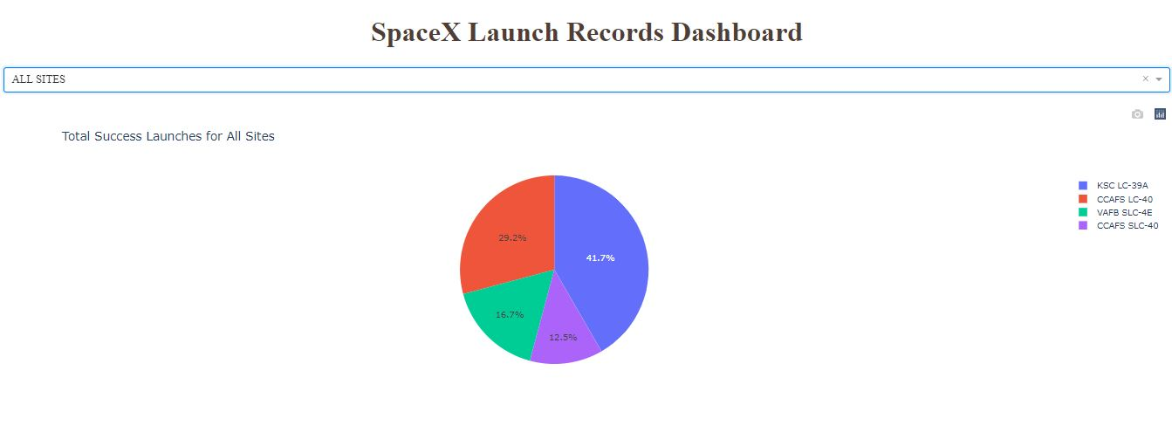
Launch Success Count for all sites Pie Chart
Launch Site KSC-LC-39A has highest count of successful launches.

Slide 41
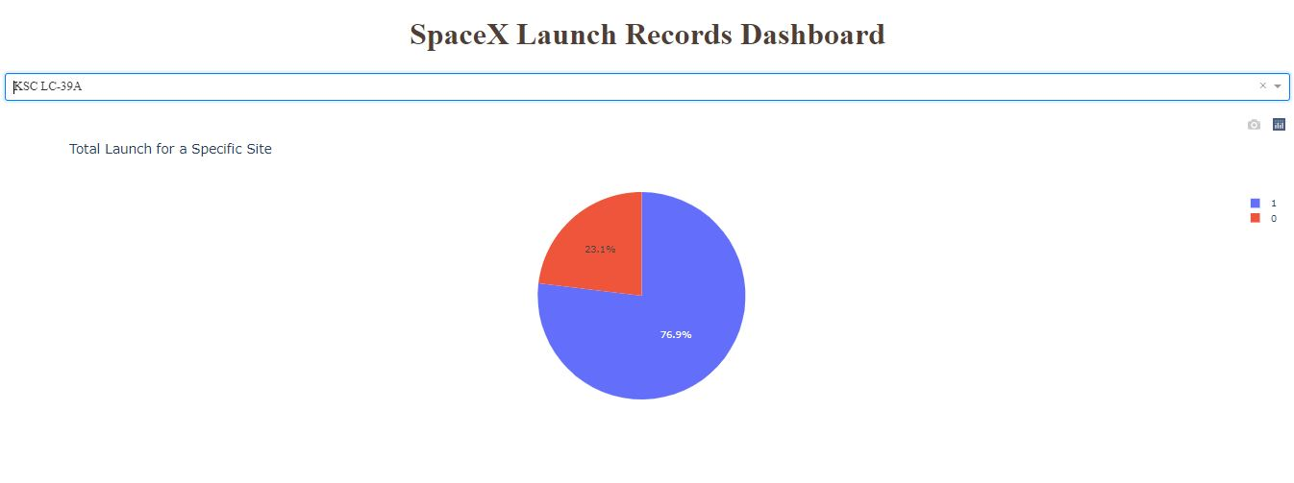
The piechart for the launch site with highest launch success ratio
Launch Site KSC-LC-39A has highest success rate of 76.9%

Slide 42
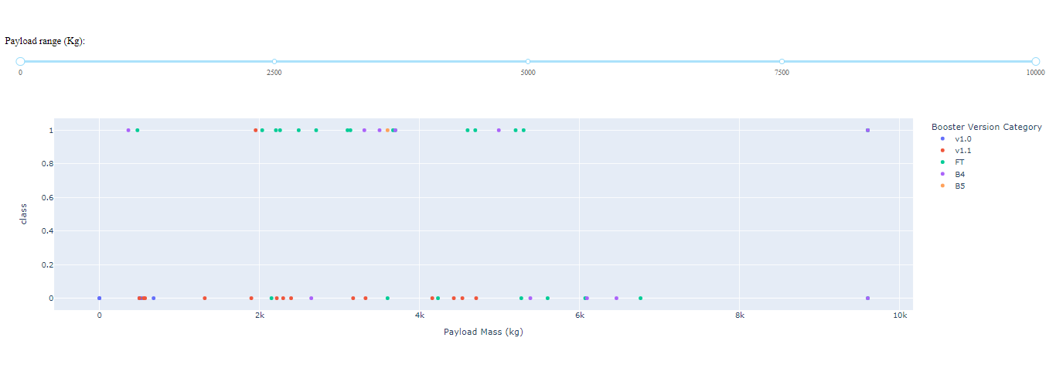
Payload vs. Launch Outcome scatter plot for all sites
No inferences can be drawn from the Scatter Chart.

Slide 43
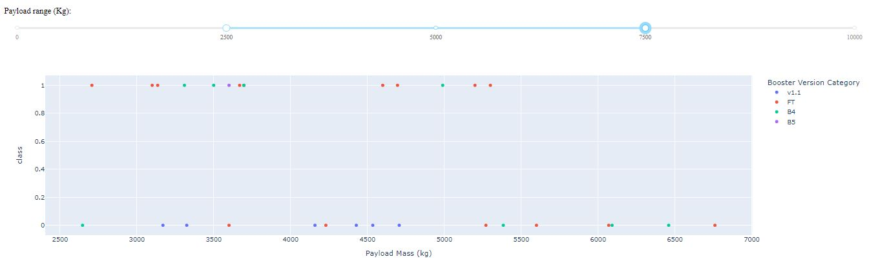
Payload vs. Launch Outcome scatter plot for all sites 2

Slide 44

Section 5

Slide 45
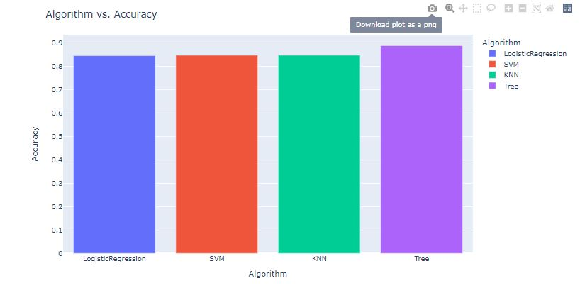
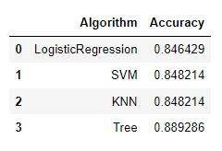
Classification Accuracy
Decision Tree Classification model has the highest accuracy on training data.
After selecting the best hyperparameters for the decision tree classifier using the validation data, we achieved 83.33% accuracy on the test data.

Slide 46
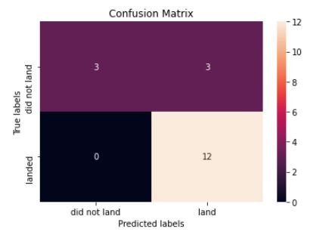
Confusion Matrix for Decision Tree Classifier
Examining the confusion matrix, we see that Tree can distinguish between the different classes. We see that the major problem is false positives.

Slide 47
Conclusions
The Tree Classifier Algorithm is the best for classification for this dataset.
The success rates for SpaceX launches increases as years pass.
Success rate improves as number of flights increases.
We can see that KSC LC-39A had the most successful launches from all the sites.
Falcon 9 launches are carried out at locations far from civilian presence like cities, highways, railways, etc.
Orbit GEO,HEO,SSO,ES-L1 has the best Success Rate.

Slide 48
Appendix
Include any relevant assets like Python code snippets, SQL queries, charts, Notebook outputs, or data sets that you may have created during this project

Slide 49


